Slide 1
Tasks and Alerts
Emanuele Della Valle
Prof. @ Politecnico di Milano
Founder & Partner @ Quantia Consulting
Marco Balduini
Founder & CEO @ Quantia Consulting
Riccardo Tommasini
Prof. @ University of Tartu

Slide 2
Motivation

Slide 3
Data-driven decision
Descriptive
What happen?
historical
analysis
Diagnostic
Why did it happen?
Predictive
What will happen?
Data
Decision
Action
Decision Support
reactive decisions
Prescriptive
What should I do?
Decision Automation
[src. Gartner]
Machine-centered
Human-Centered

Slide 4
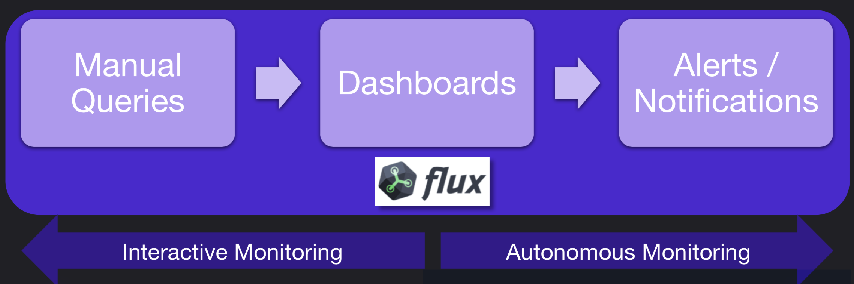
Interactive vs. Autonomous Monitoring

Slide 5

Recall
window
Data Sources
Registered Continuous Query
streams of answer
input streams
E. Della Valle

Slide 6
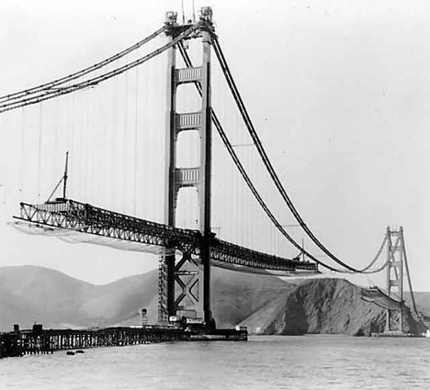
Interactive monitoring

Slide 7
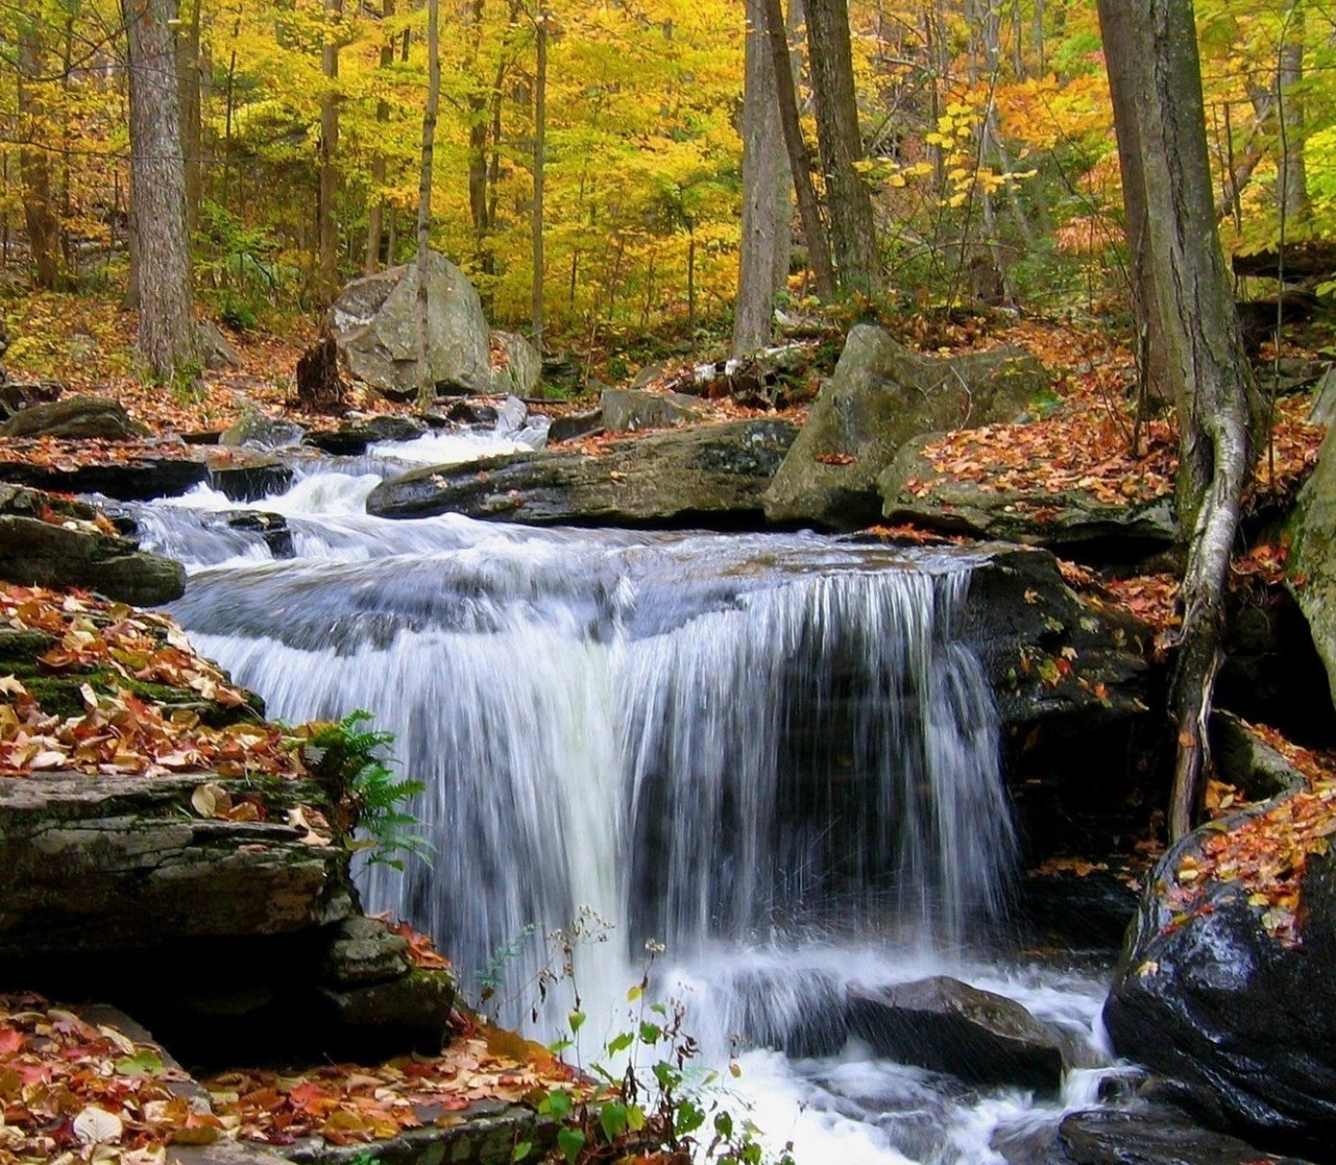
Interactive monitoring vs. Continuous autonomous monitoring

Slide 8
Anomaly Detection as running example

Slide 9
Anomaly Detection
Anomaly detection is a challenging data analysis task
Anomalies can represent
spurious data to clean out
important patterns to detect
This generality makes anomaly detection a powerful tool used in network security, remote sensing, fault detection, and many other domains
9

Slide 10
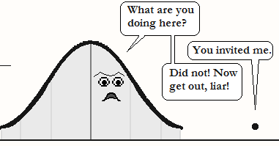
Anomaly Detection – the intuition
Considering the distribution of the data point in a time series, anomalous points are anomalies, a.k.a. outliers
[image: https://cerijayne.files.wordpress.com/2011/10/outliersss.png]
10

Slide 11
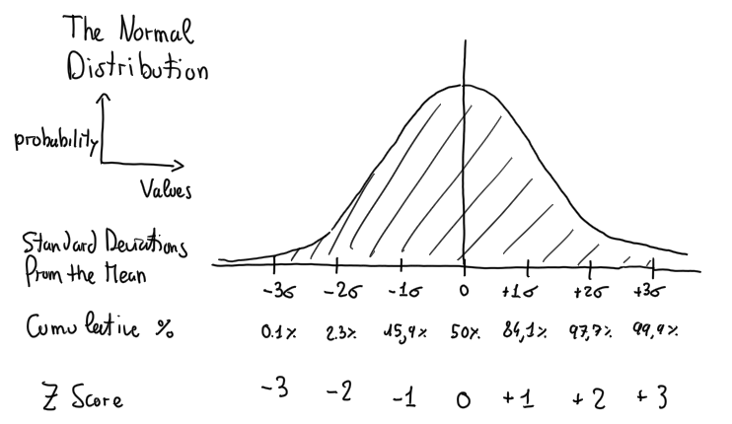
Let’s operationalize this intuition using the Z score
Z score
x – μ
σ
z
=
11

Slide 12
Let’s operationalize this intuition using the Z score
Z score
x – μ
σ
z
=
Anomaly
Abs(z) > 3
0.2% of data
12

Slide 13

A Network Security example
Finding anomalies in the number of times users inserts a wrong password when they log into a system
Refuse the access to a user that inserts the right password at the first time if she gets in average the right password after 3 attempts
Much more effective than any rule based approach
13

Slide 14
Use case for the Linear Pizza Oven
Alert me about any failure of the temperature controller of the mozzarella melting area
Correct behavior: it depends on the pizzas under production
Anomalous: ???

Slide 15
Use case for the Linear Pizza Oven
Alert me about any failure of the temperature controller of the mozzarella melting area
Correct behavior: it depends on the pizzas under production
Anomalous: let’s compute the z-score where
the Mean is computed with aggregateWindow(every: 5m, fn: mean)
the StdDev is computed with aggregateWindow(every: 5m, fn: stddev)
the Z score is computed joining the times-series of all observations with the one of the Mean and the one the StdDev

Slide 16

Let me explain it …

Slide 17
Use case for the Linear Pizza Oven – solution 1/5
movingAvg = from(bucket: "training")
|> range(start: v.timeRangeStart, stop: v.timeRangeStop)
|> aggregateWindow(every: 5m, fn: mean, createEmpty: false)
|> filter(fn: (r) => (r._stop != r._time))
|> drop(columns: ["_start", "_stop","host"])

Slide 18
Use case for the Linear Pizza Oven – solution 2/5
movingStddev = from(bucket: "training")
|> range(start: v.timeRangeStart, stop: v.timeRangeStop)
|> aggregateWindow(every: 5m, fn: stddev, createEmpty: false)
|> filter(fn: (r) => (r._stop != r._time))
|> drop(columns: ["_start", "_stop","host"])

Slide 19
Use case for the Linear Pizza Oven – solution 3/5
movingModel =
join(tables: {avg: movingAvg, stddev: movingStddev}, on: ["_field","_measurement","sensor"], method: "inner")
|> filter(fn: (r) => r._time_avg == r._time_stddev)
|> rename(columns: {_time_avg: "_time"})
|> drop(columns: ["_time_stddev"])

Slide 20
Use case for the Linear Pizza Oven – solution 4/5
allData = from(bucket: "training")
|> range(start: v.timeRangeStart, stop: v.timeRangeStop)
|> drop(columns: ["_start", "_stop", "host"])

Slide 21
Use case for the Linear Pizza Oven – solution 4/4
zscores =
join(tables: {all: allData, m: movingModel},
on: ["_field", "_measurement", "sensor"])
|> filter(fn: (r) => (uint(v: r._time_all) - uint(v: r._time_m) > 0))
|> filter(fn: (r) =>
(uint(v: r._time_all) - uint(v: r._time_m) <= 5*60*1000000000))
|> map(fn: (r) =>
({r with _value_zscore:
math.abs(x: (r._value - r._value_avg) / r._value_stddev)}))
|> rename(columns: {_time_all: "_time"})

Slide 22
Tasks

Slide 23
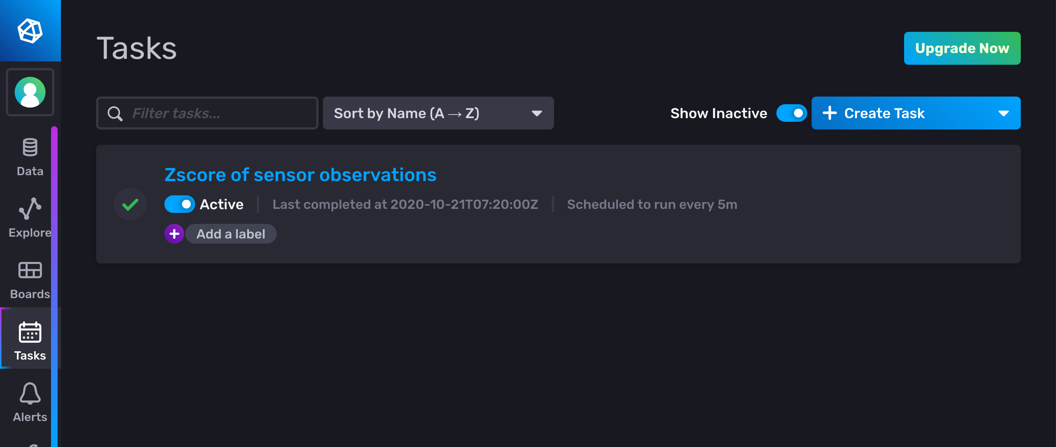
Tasks
The power of Flux for continuous processing and analysis

Slide 24
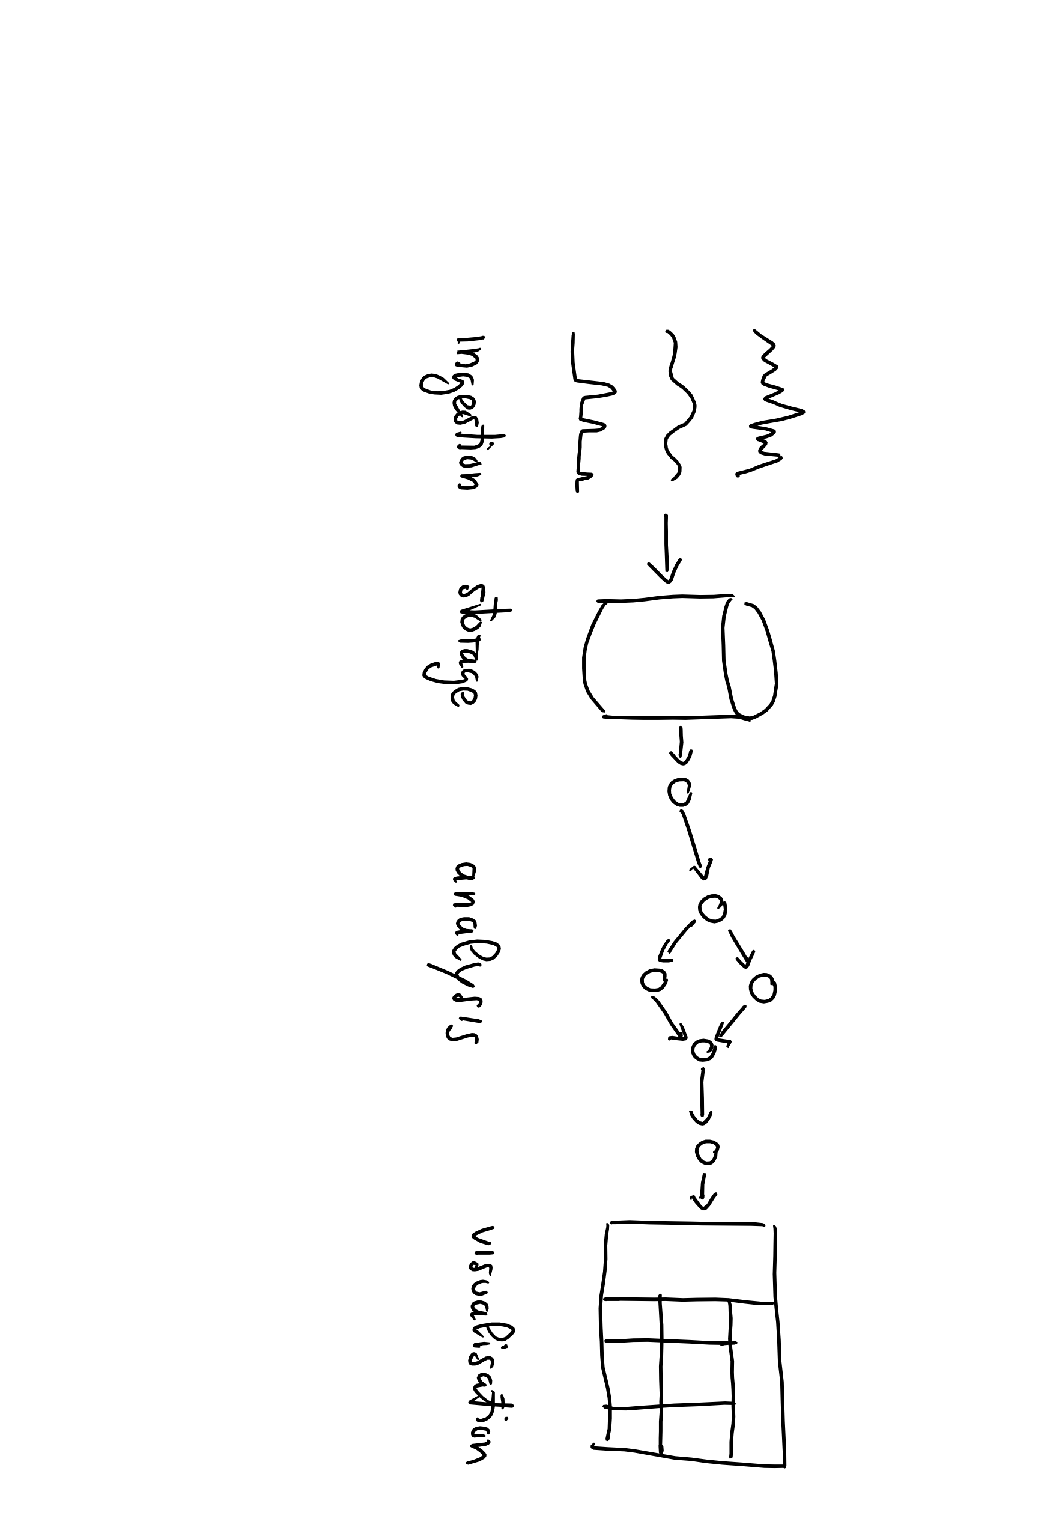
Recall the Data Lifecycle

Slide 25
Tasks continuously write back to the storage the results of the analysis

Slide 26
Writing into a bucket using to()
Syntax
to(bucket: <<name>>, org:<<organization>>)
Example
from(bucket:"foo")
|> ...
|> to(bucket: ”bar", org:”some@quantiaconsulting.com")

Slide 27
Tasks are Written in the Flux Language
No need to learn a separate language to write Tasks
No need to use separate tools for debugging Tasks
Tasks define all options within the script for portability
Options include
Name
Run Interval: every in CRON syntax
Tasks are self contained and can be imported / exported

Slide 28
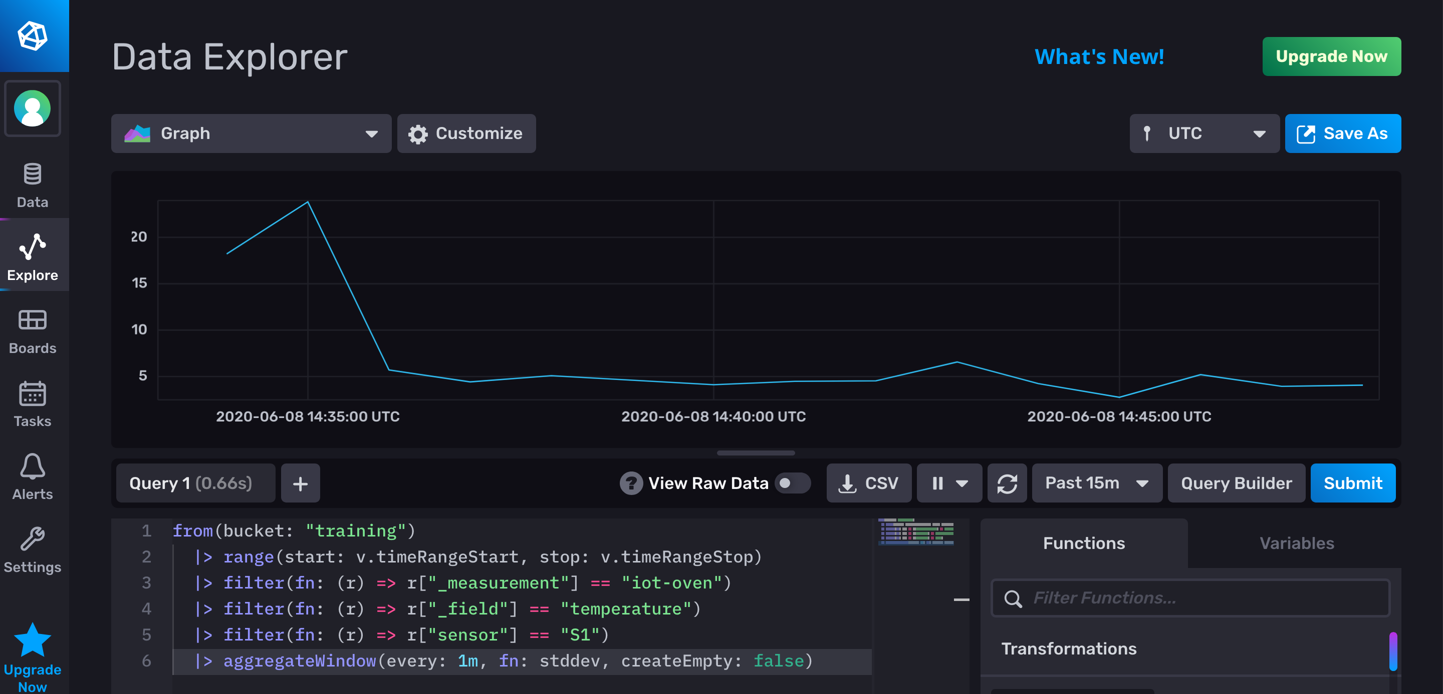
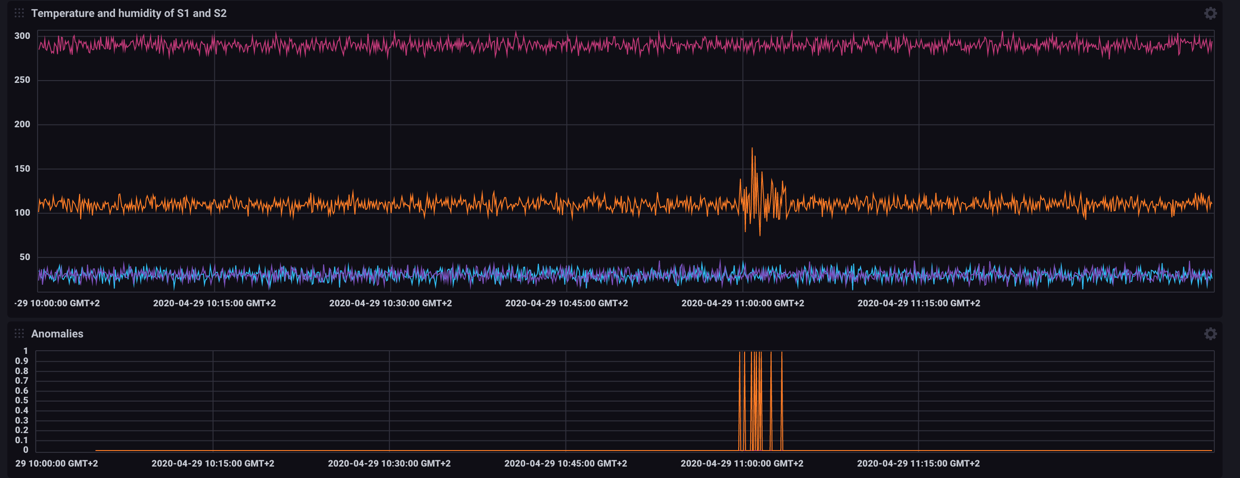
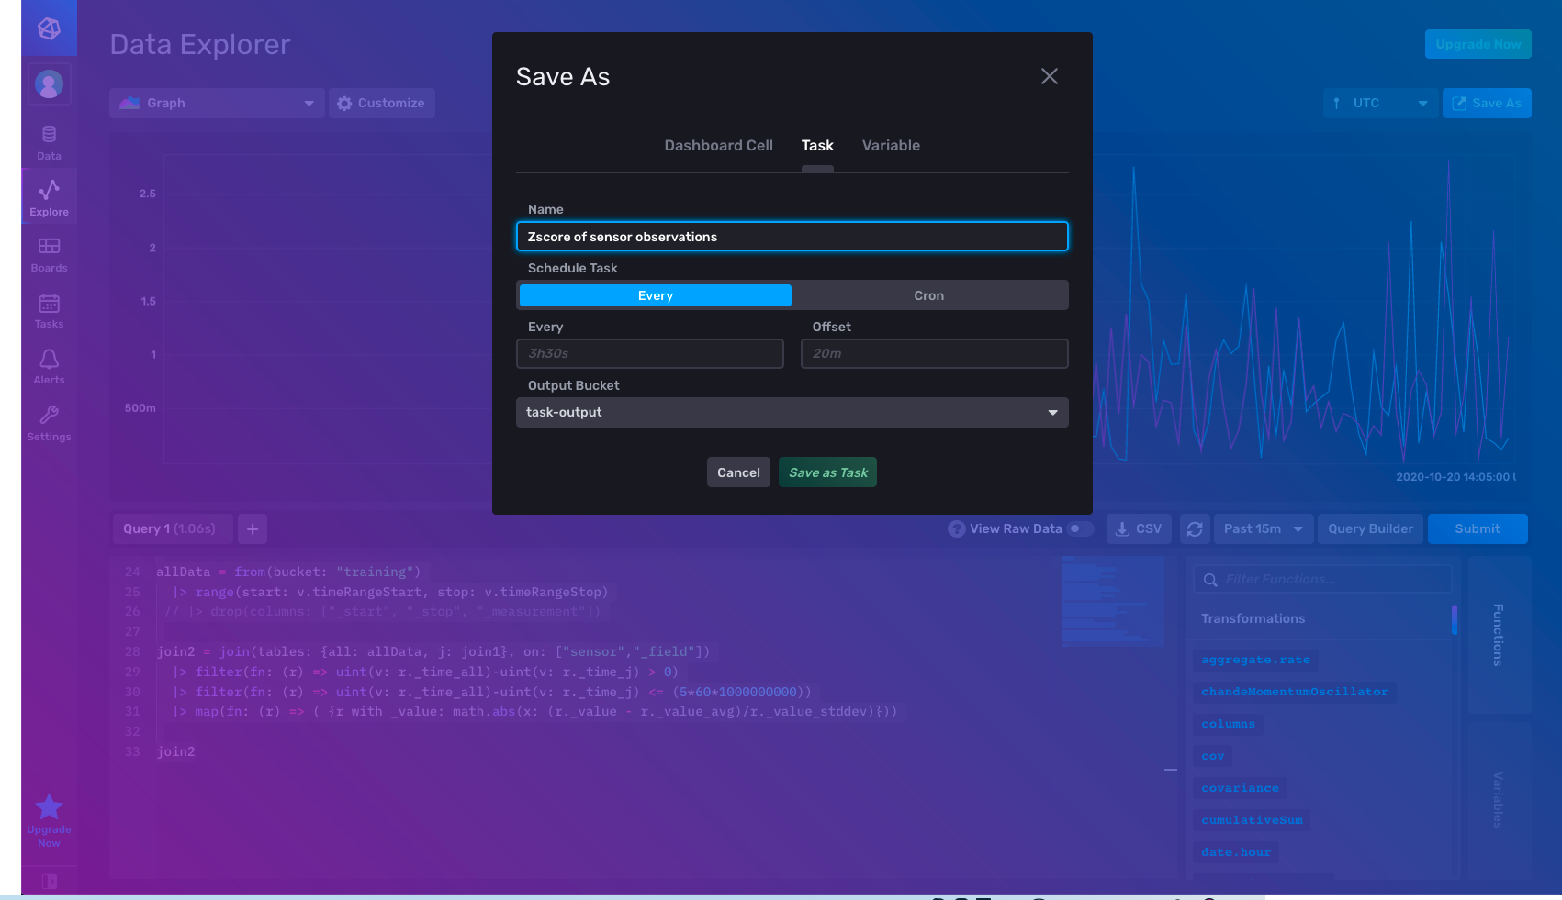
Best practice
Prepare the query in the Data Explorer
Save it as a Task

Slide 29
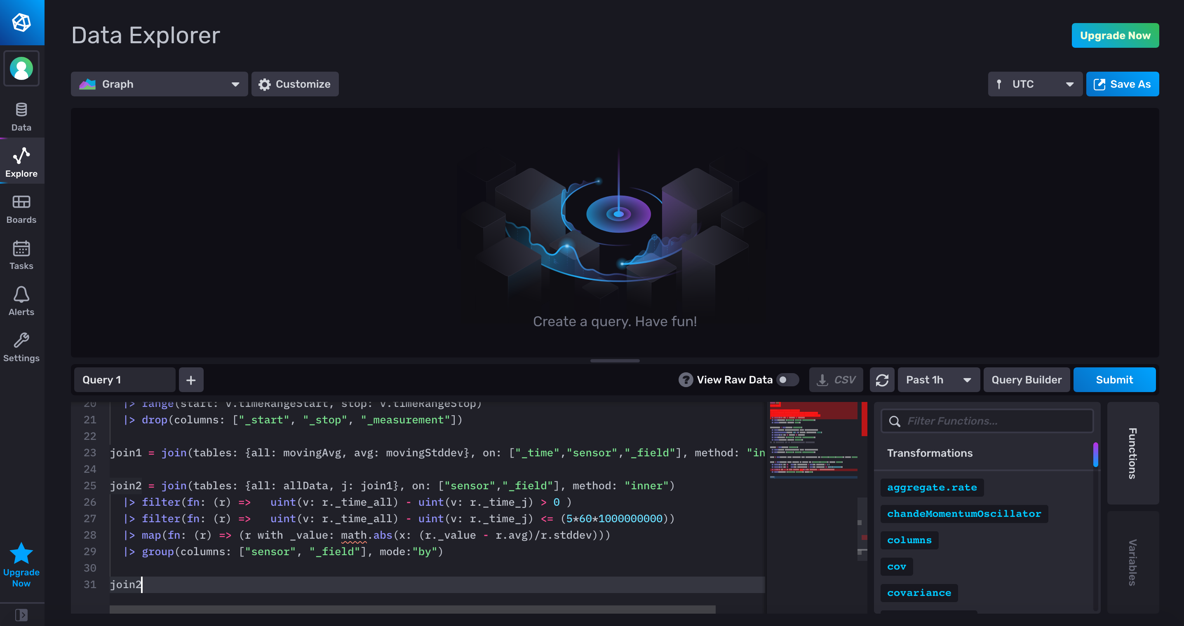
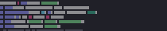
Running example: record the moving z-score

Slide 30
Running example: record the moving z-score

Slide 31
Alerts

Slide 32
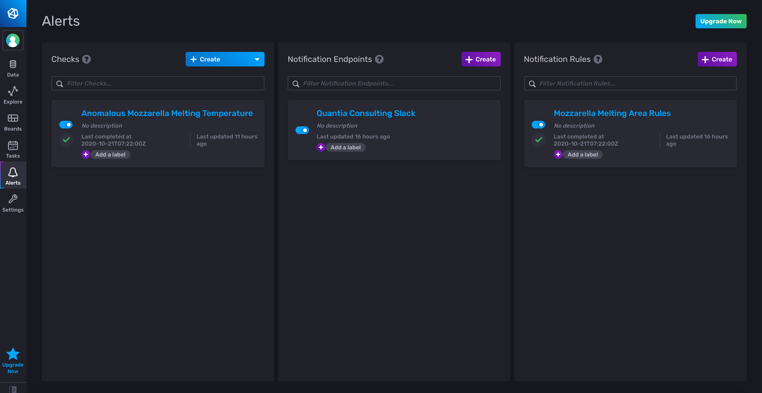
Alerts
Types of Alerts
Threshold
Deadman
Alerts are defined as
a base query
threshold criteria
condition mapping
notifications

Slide 33
Alert-UI

Slide 34
Alert-UI - Checks

Slide 35
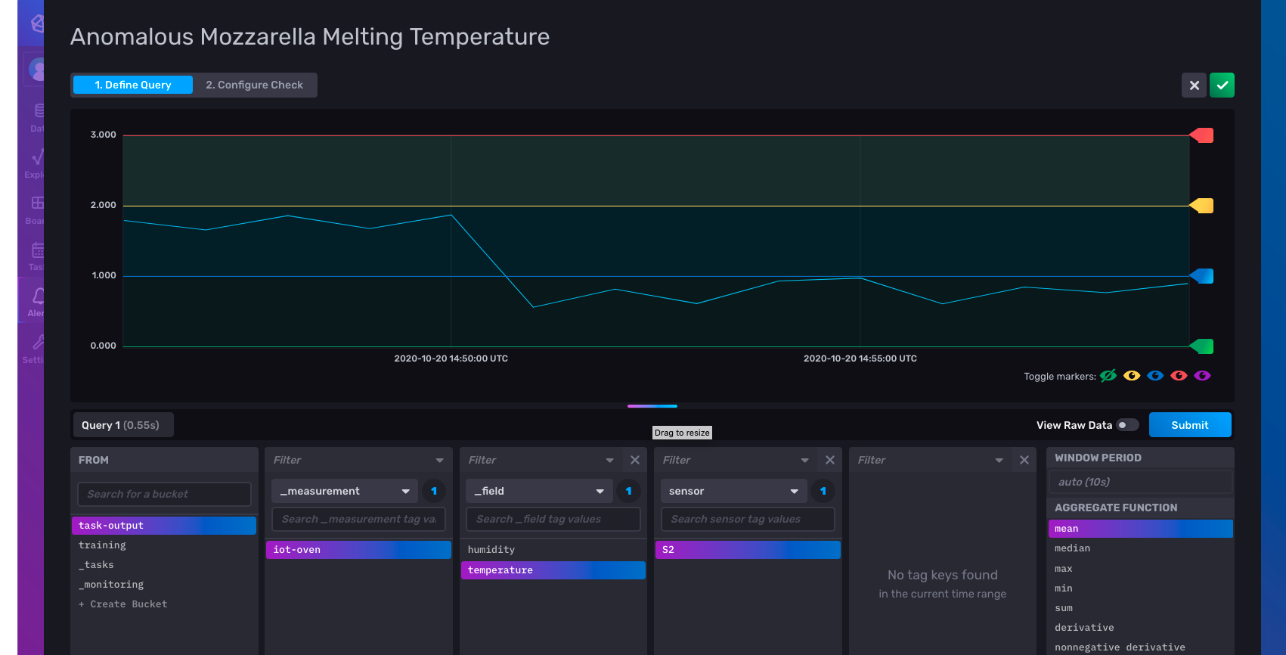
Alerts UI – check view – query pane
base query

Slide 36
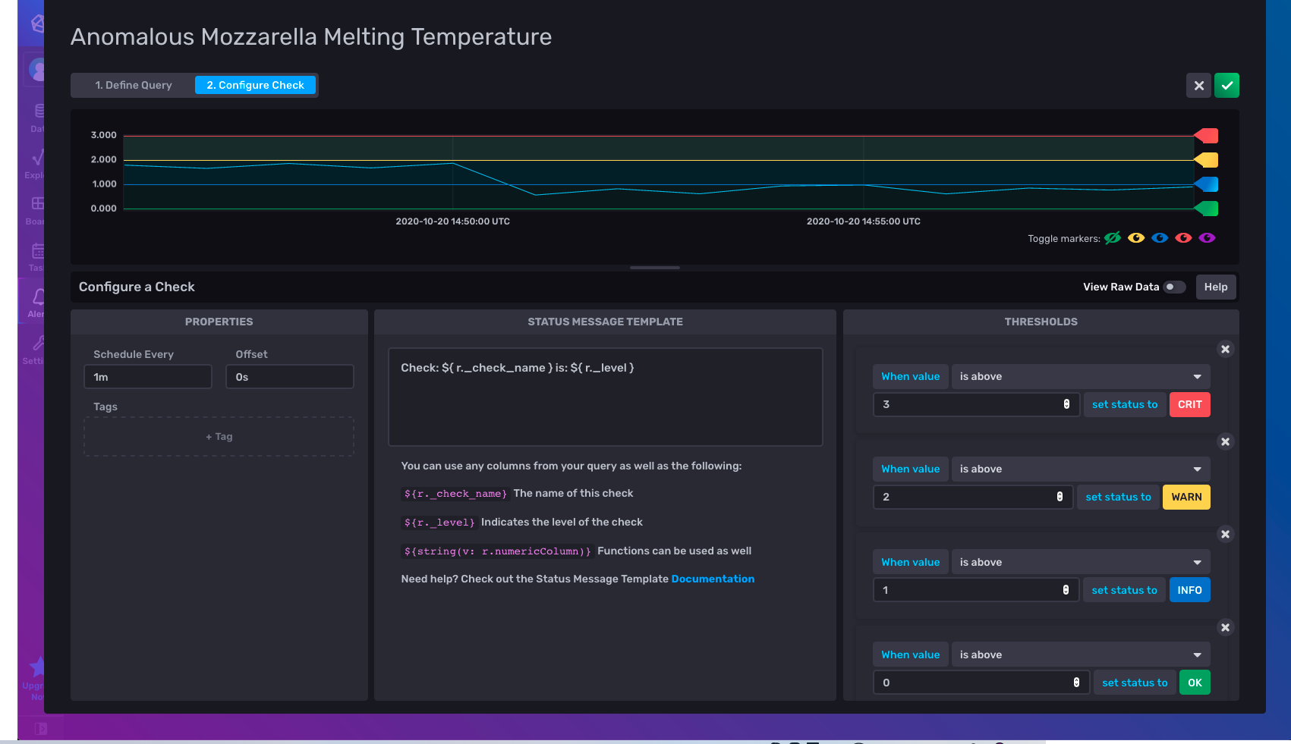
Alerts UI – check view – check pane
critic condition threshold
z-score > 3
warn condition threshold
z-score > 2
threshold criteria
condition mapping

Slide 37
Notifications
Possibility to define
Notification endpoints on a Slack channel

Slide 38
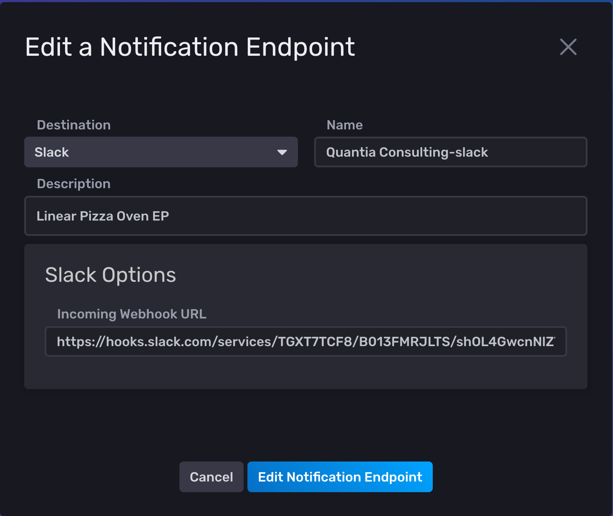
Notifications
Possibility to define
Notification endpoints on a Slack channel
Notification rules
When
What

Slide 39
Notifications
Possibility to define
Notification rules
When
What

Slide 40
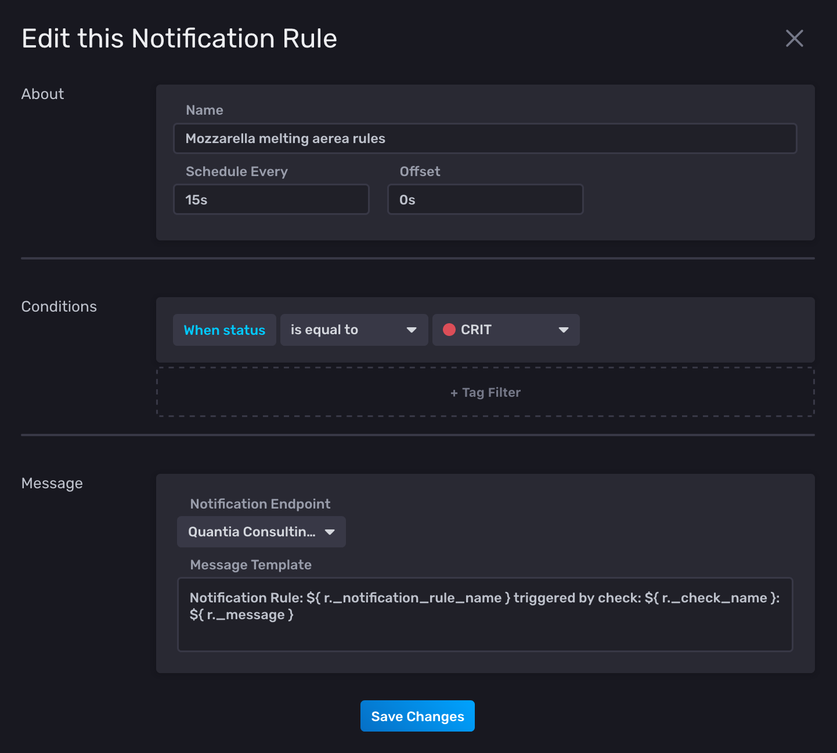
Notifications
Possibility to define
Notification rules
When
What

Slide 41
Tasks and Alerts
Emanuele Della Valle Prof. @ Politecnico di Milano & Partner @ Quantia Consulting
Marco Balduini Founder & CEO @ Quantia Consulting
Riccardo Tommasini Prof. @ University of Tartu

